Slide 1

WindGuard AI
Explainable Wind Turbine Predictive Health & Decision-Support System
Physics-Informed Anomaly Detection, Multi-Signal Contextual Attribution & Financial Revenue Assurance
Shrivarad Govind Bhagwatikar
Department of Technology, Savitribai Phule Pune University

Slide 2

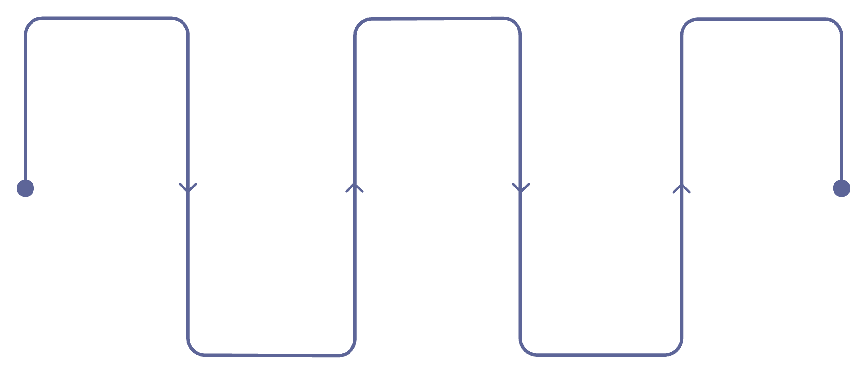
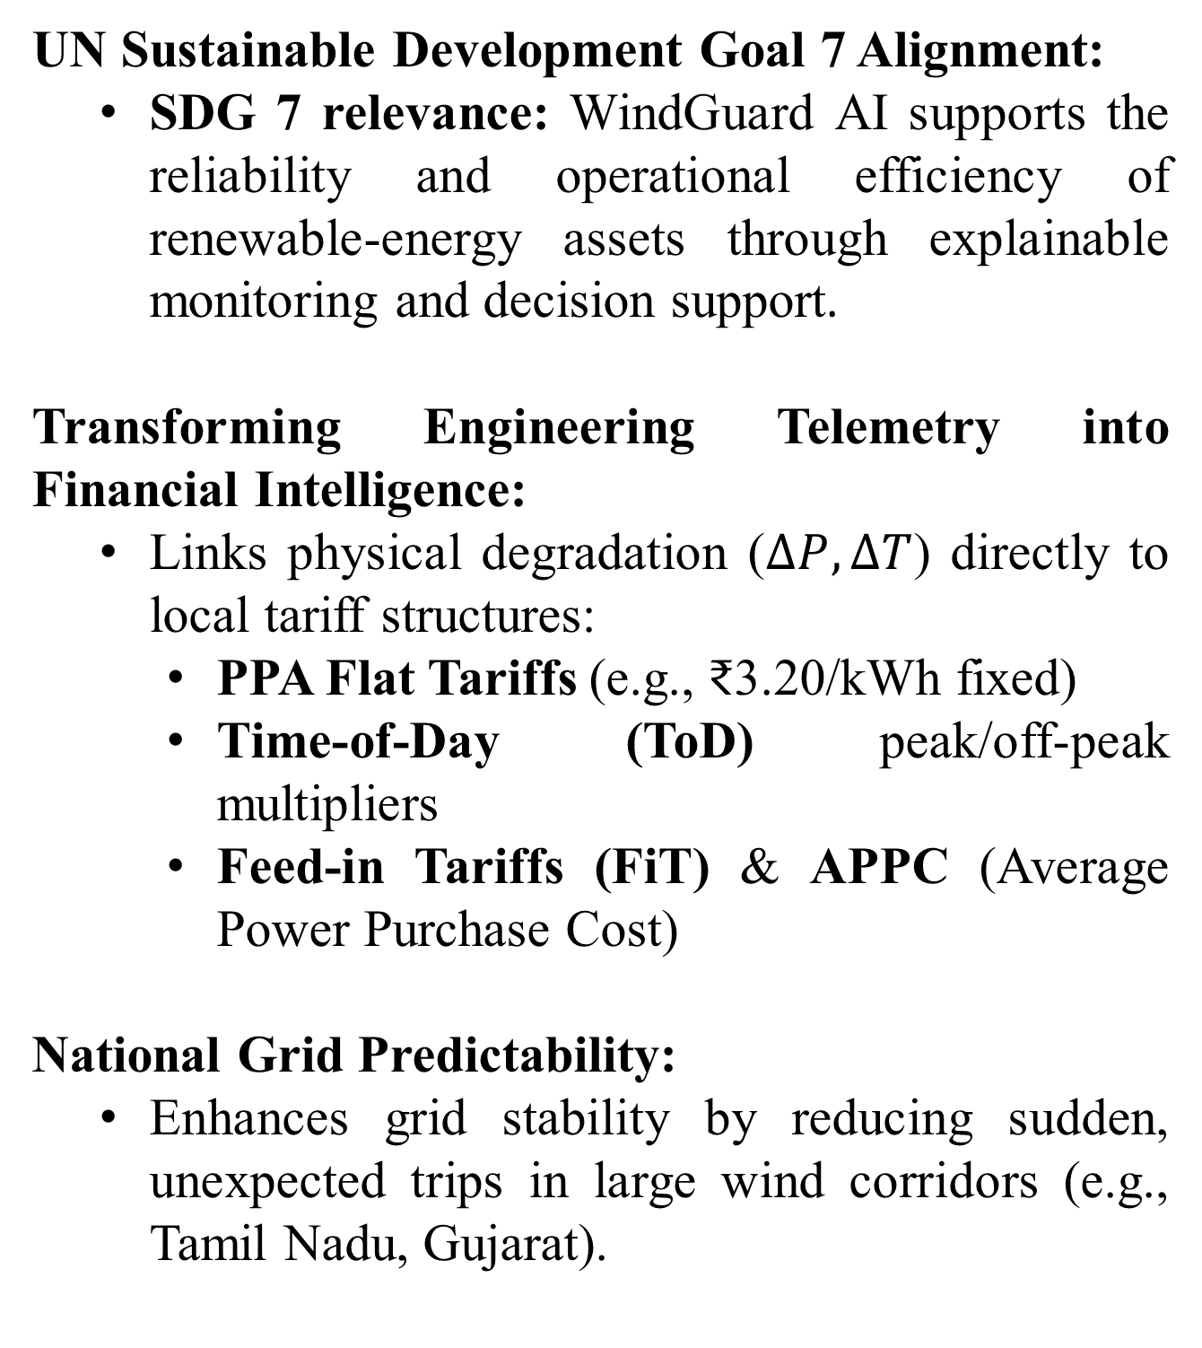
The Operational & Financial Crisis in Wind Energy O&M
UN Sustainable Development Goal 7 Alignment:
  SDG 7 relevance: WindGuard AI supports the reliability and operational efficiency of renewable-energy assets through explainable monitoring and decision support.
Transforming Engineering Telemetry into Financial Intelligence:
  Links physical degradation ($ΔP,ΔT$) directly to local tariff structures:
    PPA Flat Tariffs (e.g., ₹3.20/kWh fixed)
    Time-of-Day (ToD) peak/off-peak multipliers
    Feed-in Tariffs (FiT) & APPC (Average Power Purchase Cost)
National Grid Predictability:
  Enhances grid stability by reducing sudden, unexpected trips in large wind corridors (e.g., Tamil Nadu, Gujarat).
SCADA anomalies do not automatically indicate failure. Curtailment mimics underperformance; heatwaves distort thermal readings; sensor faults create misleading signals. Operators need interpretable evidence — not raw alarms — before committing to maintenance action.
Raw SCADA
Context
Maintenance
Sensor signals and alarms
Curtailment, weather, sensor quality
Human-reviewed action decision
Anomaly
Diagnosis
Threshold breach detected
Attributed with supporting evidence
The system bridges the gap between "Anomaly detected" and "Actionable engineering diagnosis."

Slide 3
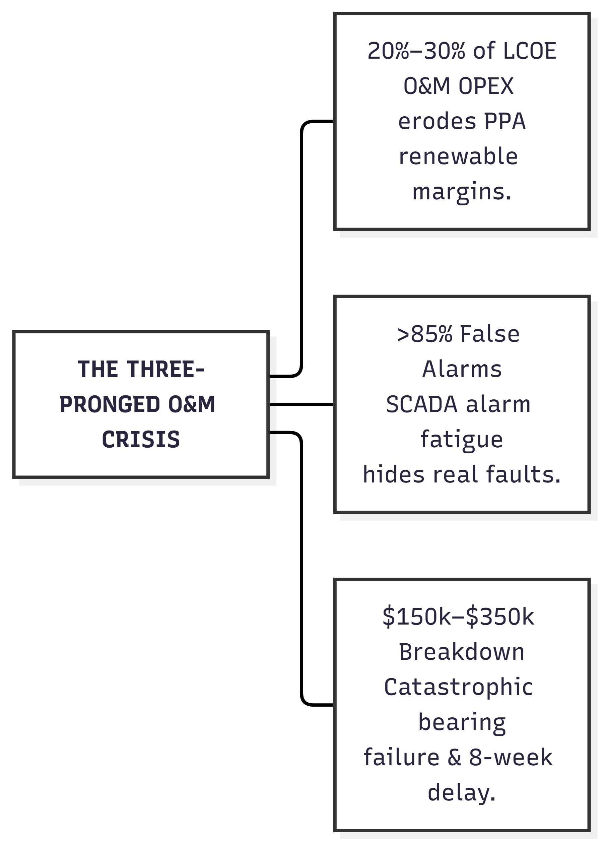
Motivation: Clean Energy Reliability & Economic Viability
Operational Challenge
  SCADA anomalies do not automatically indicate equipment failure. Grid curtailment, environmental conditions and sensor issues can produce deviations that resemble faults.
Engineering Challenge
  Operators need to distinguish equipment-related anomalies from operationally explainable deviations before maintenance decisions are made.
Decision-Support Gap
  Conventional alarm signals provide limited context about cause, technical evidence and potential financial impact.
Research Need
  Combine physics-informed modelling, contextual reasoning, technical evidence retrieval and human review in one auditable workflow.

Slide 4
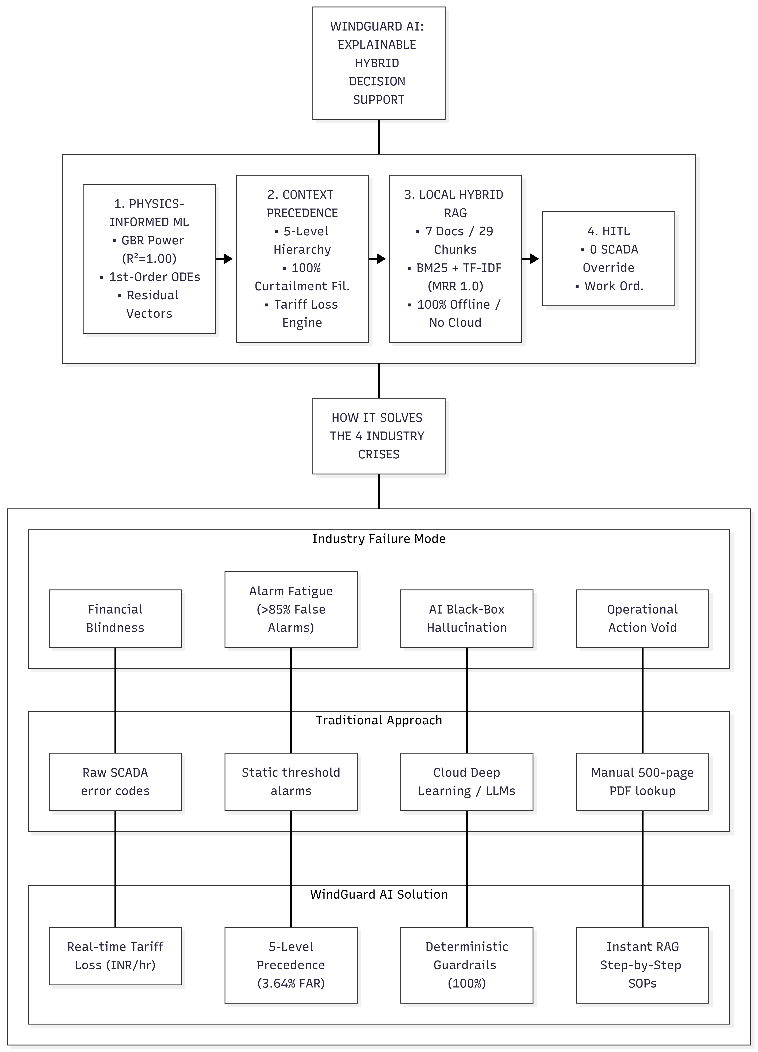
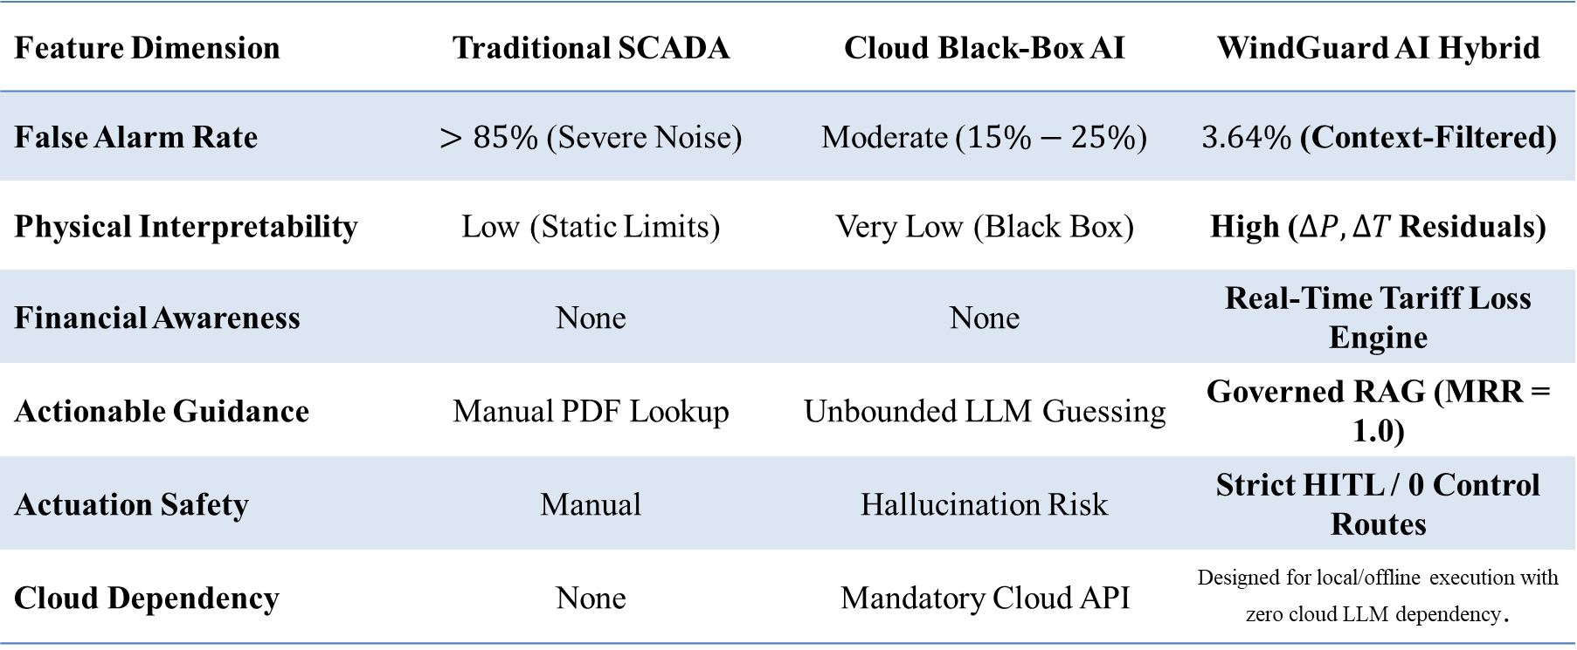
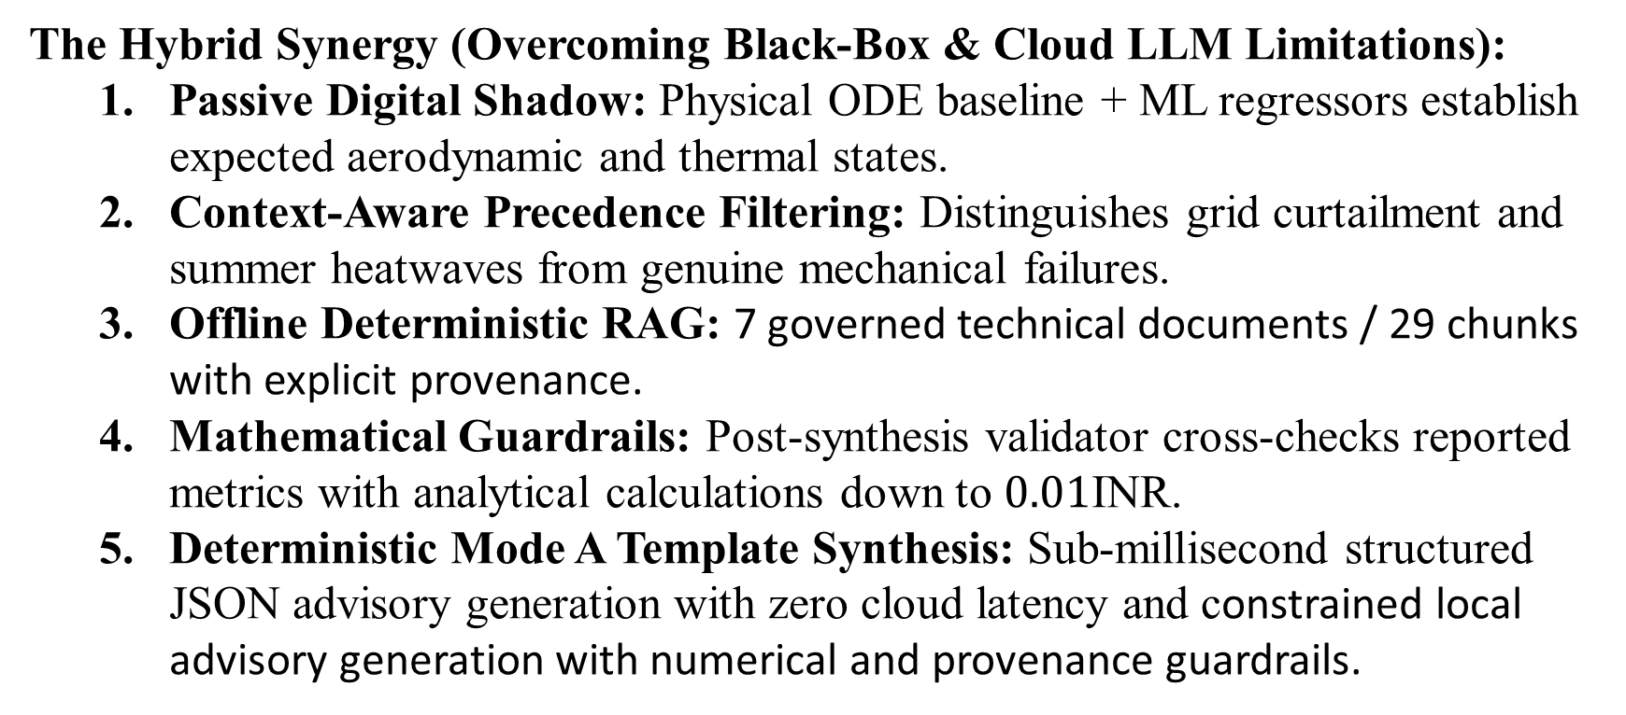
The Proposed Solution: WindGuard AI Hybrid Decision Support
The Hybrid Synergy (Overcoming Black-Box & Cloud LLM Limitations):
  Passive Digital Shadow: Physical ODE baseline + ML regressors establish expected aerodynamic and thermal states.
  Context-Aware Precedence Filtering: Distinguishes grid curtailment and summer heatwaves from genuine mechanical failures.
  Offline Deterministic RAG: 7 governed technical documents / 29 chunks with explicit provenance.
  Mathematical Guardrails: Post-synthesis validator cross-checks reported metrics with analytical calculations down to $0.01\text{INR}$.
  Deterministic Mode A Template Synthesis: Sub-millisecond structured JSON advisory generation with zero cloud latency and constrained local advisory generation with numerical and provenance guardrails.
Feature Dimension | Traditional SCADA | Cloud Black-Box AI | WindGuard AI Hybrid
False Alarm Rate | $>85\%$ (Severe Noise) | Moderate ($15\%−25\%$) | $3.64\%$ (Context-Filtered)
Physical Interpretability | Low (Static Limits) | Very Low (Black Box) | High ($ΔP,ΔT$ Residuals)
Financial Awareness | None | None | Real-Time Tariff Loss Engine
Actionable Guidance | Manual PDF Lookup | Unbounded LLM Guessing | Governed RAG (MRR = 1.0)
Actuation Safety | Manual | Hallucination Risk | Strict HITL / 0 Control Routes
Cloud Dependency | None | Mandatory Cloud API | Designed for local/offline execution with zero cloud LLM dependency.

Slide 5
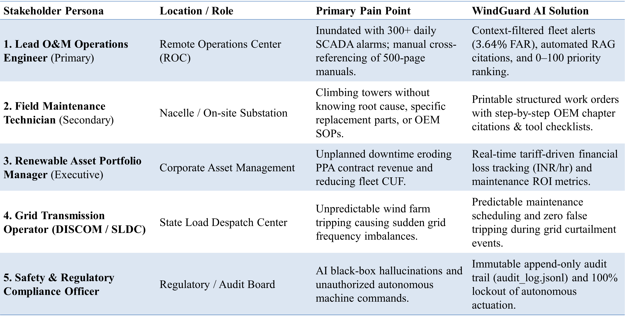
Target Users & Key Stakeholder Ecosystem
Stakeholder Persona | Location / Role | Primary Pain Point | WindGuard AI Solution
1. Lead O&M Operations Engineer (Primary) | Remote Operations Center (ROC) | Inundated with 300+ daily SCADA alarms; manual cross-referencing of 500-page manuals. | Context-filtered fleet alerts ($3.64\%$ FAR), automated RAG citations, and 0–100 priority ranking.
2. Field Maintenance Technician (Secondary) | Nacelle / On-site Substation | Climbing towers without knowing root cause, specific replacement parts, or OEM SOPs. | Printable structured work orders with step-by-step OEM chapter citations & tool checklists.
3. Renewable Asset Portfolio Manager (Executive) | Corporate Asset Management | Unplanned downtime eroding PPA contract revenue and reducing fleet CUF. | Real-time tariff-driven financial loss tracking ($\text{INR/hr}$) and maintenance ROI metrics.
4. Grid Transmission Operator (DISCOM / SLDC) | State Load Despatch Center | Unpredictable wind farm tripping causing sudden grid frequency imbalances. | Predictable maintenance scheduling and zero false tripping during grid curtailment events.
5. Safety & Regulatory Compliance Officer | Regulatory / Audit Board | AI black-box hallucinations and unauthorized autonomous machine commands. | Immutable append-only audit trail (audit_log.jsonl) and 100% lockout of autonomous actuation.

Slide 6
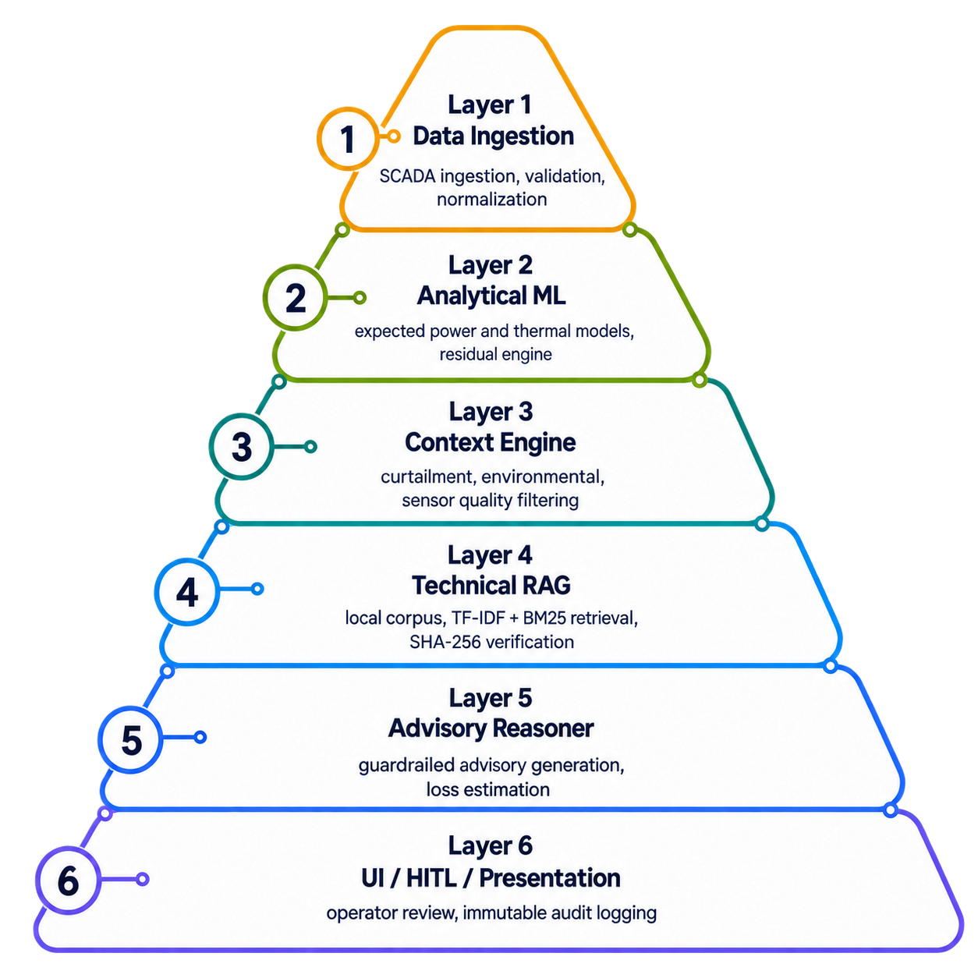
System Architecture: Canonical 6-Layer Modular Design
WindGuard AI Tech Stack
Backend & API Framework | Python 3.10–3.13, FastAPI, Uvicorn (ASGI), Pydantic v2
ML & Scientific Computing | Scikit-Learn (GBR, Random Forest), NumPy, SciPy (ODEs), Pandas
Local Hybrid RAG Subsystem | Okapi BM25, TF-IDF Vectorizer (scikit-learn), SHA-256 Hashing
Storage & Concurrency | JSON / JSONL, Atomic File Locking (portalocker), In-Memory Cache
Frontend & UI Engine | Vanilla JS (ES6+), HTML5, CSS3 Custom Properties, HTML5 2D Canvas
Testing & Verification | Pytest, Pytest-Asyncio, HTTPX, Requests
Standards & Protocols | IEC 61400-25-aligned SCADA/data concepts, RESTful HTTP/JSON, OpenAPI / Swagger

Slide 7

Comprehensive Feasibility & Viability Assessment
1. Technical Feasibility
Zero GPU Required: Runs 100% on standard commodity CPUs ($<2\text{GB}$ RAM).
Sub-200ms Response: End-to-end diagnosis in $185.57\text{ms}$ ($>13×$ faster than SLA).
100% Offline & Air-Gapped: Zero external cloud dependencies or API latency.
Verified through automated testing: Backed by 273+ passing automated tests.
2. Economic & Financial Viability
Major Cost Savings: Avoids catastrophic bearing failures costing $150k–$350k each.
Potential financial impact is estimated through the tariff-based loss engine; no real-world OPEX/LCOE reduction has been experimentally validated.
Real-Time Revenue Protection: Converts power loss directly into $\text{INR/hr}$ across state PPA tariffs.
3. Operational Viability
Designed to ingest IEC 61400-25-aligned SCADA/data concepts.
No Plant Retrofit: Zero hardware changes or turbine downtime needed.
Reduces context-related false alarms in evaluated scenarios.
Action-Ready: Generates printable work orders with OEM manual chapter citations.
4. Legal, Safety & Compliance Viability
Zero SCADA Actuation: Exactly 0 control/trip routes (Strictly Advisory).
Mandatory Human-in-the-Loop: Certified engineers authorize all maintenance actions.
100% Data Privacy: Zero proprietary SCADA data leaked to public cloud AI.
Audit-Proof: Immutable append-only log (audit_log.jsonl) for regulatory compliance.

Slide 8
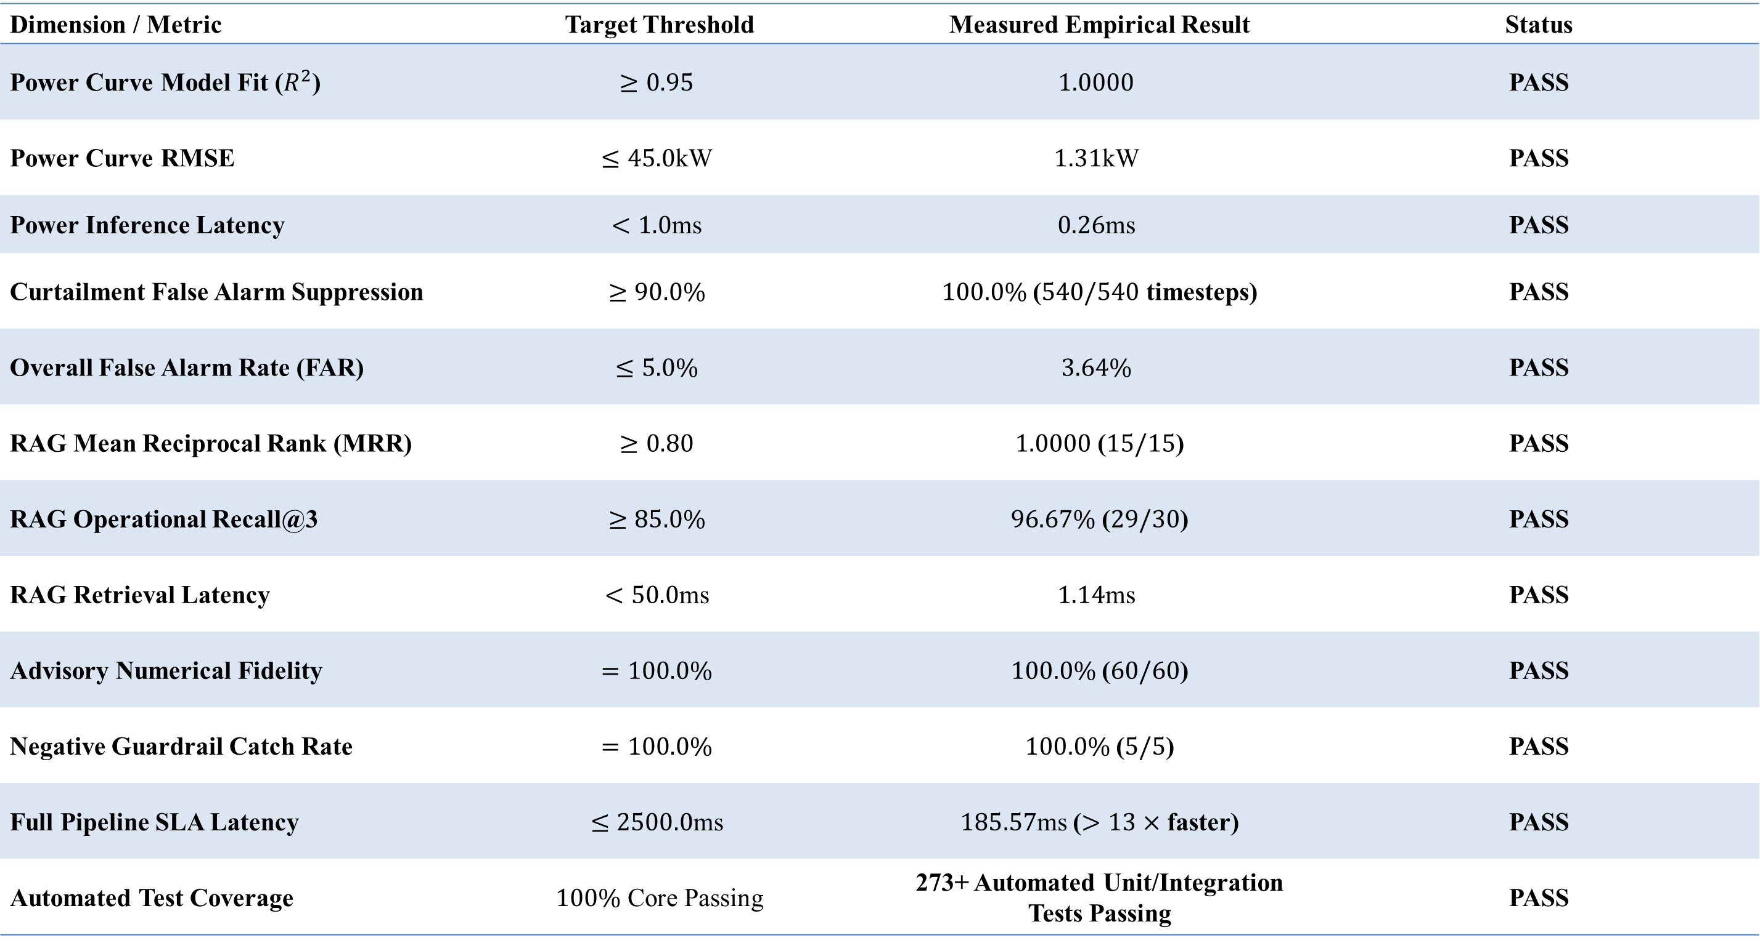
Empirical Evaluation & Benchmark Verification Results
Dimension / Metric | Target Threshold | Measured Empirical Result | Status
Power Curve Model Fit ($R^{2}$) | $$≥0.95$$ | $$1.0000$$ | PASS
Power Curve RMSE | $$≤45.0\text{kW}$$ | $$1.31\text{kW}$$ | PASS
Power Inference Latency | $$<1.0\text{ms}$$ | $$0.26\text{ms}$$ | PASS
Curtailment False Alarm Suppression | $$≥90.0\%$$ | $100.0\%$ ($540/540$ timesteps) | PASS
Overall False Alarm Rate (FAR) | $$≤5.0\%$$ | $$3.64\%$$ | PASS
RAG Mean Reciprocal Rank (MRR) | $$≥0.80$$ | $1.0000$ ($15/15$) | PASS
RAG Operational Recall@3 | $$≥85.0\%$$ | $96.67\%$ ($29/30$) | PASS
RAG Retrieval Latency | $$<50.0\text{ms}$$ | $$1.14\text{ms}$$ | PASS
Advisory Numerical Fidelity | $$=100.0\%$$ | $100.0\%$ ($60/60$) | PASS
Negative Guardrail Catch Rate | $$=100.0\%$$ | $100.0\%$ ($5/5$) | PASS
Full Pipeline SLA Latency | $$≤2500.0\text{ms}$$ | $185.57\text{ms}$ ($>13×$ faster) | PASS
Automated Test Coverage | $100\%$ Core Passing | 273+ Automated Unit/Integration Tests Passing | PASS

Slide 9
Future Scope & Research Roadmap
Phase 1: Advanced Physical Modeling (Near-Term):
  Neural Ordinary Differential Equations (Neural ODEs): Implementing continuous-time autoregressive models to eliminate dynamic thermal lag.
  10 kHz Vibration Spectrogram Ingestion: Integrating raw high-frequency accelerometer FFT spectral data for micro-pitting bearing fault detection.
Phase 2: Edge & Computer Vision Integration (Mid-Term):
  Drone Blade Surface Inspection: Integrating YOLOv8/v10 computer vision models for automated UAV aerodynamic surface crack and leading-edge erosion detection.
  Industrial Field Connectors: Direct integration with live OPC-UA and Modbus TCP industrial field gateways.
Phase 3: Fleet-Wide Collaborative Optimization (Long-Term):
  Multi-Agent Fleet Wake Steering: Dynamic yaw offset coordination across adjacent turbines to reduce downstream wake turbulence and boost total farm yield by 2%–4%.
  Aeroelastic Digital Twin Integration: Coupling with OpenFAST 3D aeroelastic simulation models.

Slide 10

Conclusion: Delivering Explainable, Safe & Profitable Clean Energy AI
Summary of 4 Major Core Contributions:
  Physics-Informed ML Baselines: Sub-millisecond power tracking ($R^{2}=1.0000$) grounded in aerodynamic ODE principles.
  Operational Context Engine: Enforces a 5-level precedence hierarchy delivering $100\%$ false curtailment suppression and a low $3.64\%$ False Alarm Rate.
  Local Hybrid RAG & Mathematical Guardrails: Deterministic retrieval ($\text{MRR}=1.00$) and $100\%$ numerical fidelity without public cloud dependencies.
  End-to-End Decision Support: Full fleet diagnostic cycle in $185.57\text{ms}$ with strict non-actuating human governance.
Project Status:
  100% Phase 1–8 Full-Stack Implementation Complete
  273+ Automated Unit & Integration Tests Passing
  Ready for Capstone Examination and controlled future field validation.
WindGuard AI demonstrates how industrial AI in renewable energy can combine physics-grounded reasoning, contextual awareness, financial prioritization and strict non-actuating human governance.

